Slide 1
Adaptative and Nonlinear Control
Individual Project

Slide 2
1. Introduction

Slide 3
1.1 Introduction Path Planning – Context & Architecture integration
Autonomous: the ability of a system to achieve its goals while operating independently of external controls, so itself is capable of these 3 fundamental actions:
1. Perception: extract information from the sensors (both exteroceptive and proprioceptive) and update the map and location of the system (performed by the SLAM).
2. Cognition: by considering its state, the goal and additional parameters (environmental variables, performance constrains, etc.), obtaining a plan to follow (path, orientation & trajectory).
3. Action: given the desired maneuver, the system commands the inputs to properly follow it.
In the previous project, the focus was made into the high-frequency action phase, while now the cognition process is the highlighted one. In particular, the path planning is going to be the main topic of the presentation.
Position Controller
Allocation
Cognition
Action
Perception

Slide 4
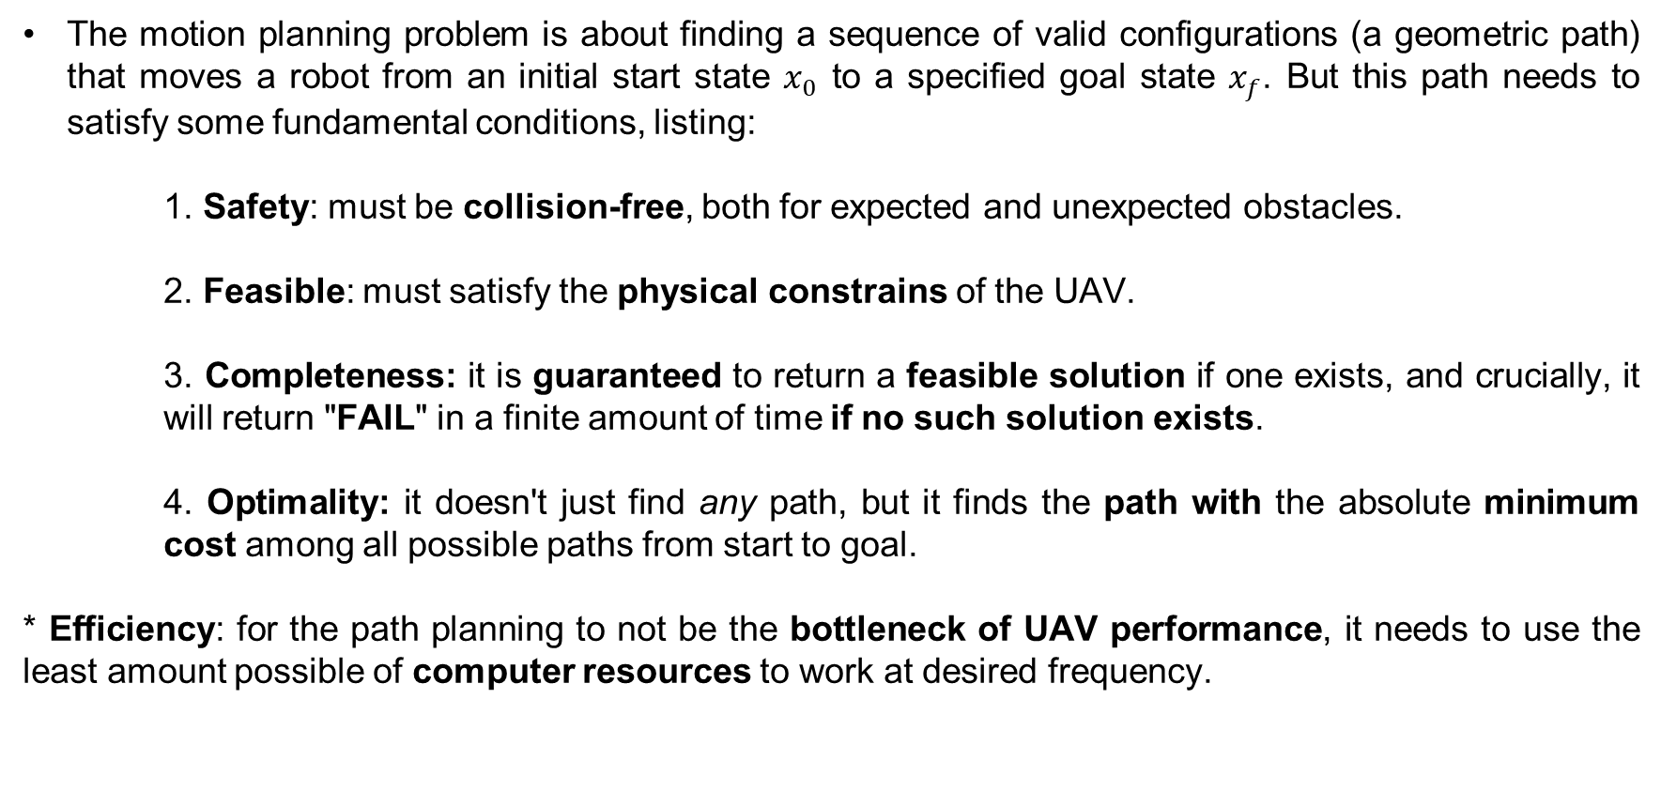
1.1 Introduction Path Planning
The motion planning problem is about finding a sequence of valid configurations (a geometric path) that moves a robot from an initial start state $x_{0}$ to a specified goal state $x_{f}$. But this path needs to satisfy some fundamental conditions, listing:
1. Safety: must be collision-free, both for expected and unexpected obstacles.
2. Feasible: must satisfy the physical constrains of the UAV.
3. Completeness: it is guaranteed to return a feasible solution if one exists, and crucially, it will return "FAIL" in a finite amount of time if no such solution exists.
4. Optimality: it doesn't just find any path, but it finds the path with the absolute minimum cost among all possible paths from start to goal.
* Efficiency: for the path planning to not be the bottleneck of UAV performance, it needs to use the least amount possible of computer resources to work at desired frequency.
Position Controller
Allocation

Slide 5
1.1 Introduction Path Planning – Different Methods
The first two algorithms developed for path planning are Dijkstra's and A*. They will serve as a basis for explaining the behavior of more advanced ones, and the main topic of this presentation, D* lite and AI powered methods.
- Dijkstra's method:
While this method is complete and optimal, there are two main disadvantages that makes it obsolete: need to perfectly know the environment; any modification in it make necessary the complete re-computation of the path, and because it performs the evaluation in the full grid, its highly cost in high order systems really limits its applications.
Position Controller
Allocation
Initialize node
Set starting node value to 0
Explore unvisited nodes
Calculation of new cost (initial node cost + edge distance)
Update
Check if this new cost is cheaper than the previous
Close
Once every neighbor has been checked, it is already known the shortest path to this node. Check as visited.
Repeat
Pick the next unvisited node

Slide 6
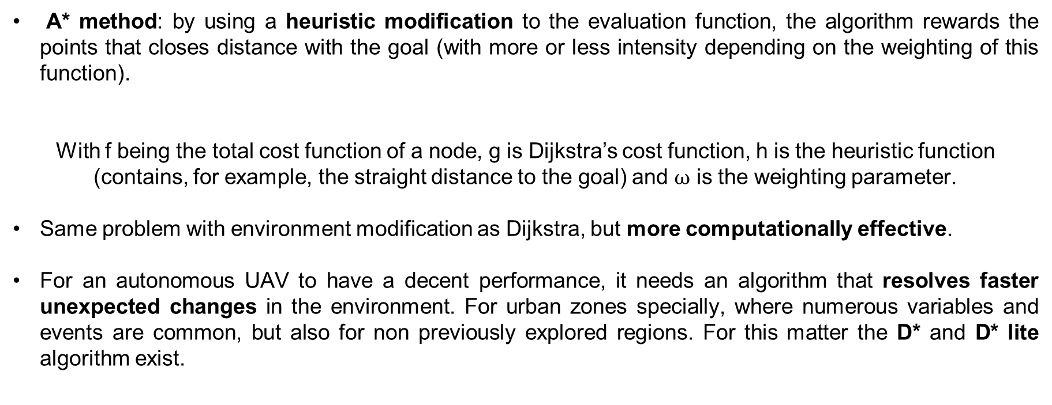

1.1 Introduction Path Planning – Different Methods
A* method: by using a heuristic modification to the evaluation function, the algorithm rewards the points that closes distance with the goal (with more or less intensity depending on the weighting of this function).
With f being the total cost function of a node, g is Dijkstra’s cost function, h is the heuristic function (contains, for example, the straight distance to the goal) and $ω$ is the weighting parameter.
Same problem with environment modification as Dijkstra, but more computationally effective.
For an autonomous UAV to have a decent performance, it needs an algorithm that resolves faster unexpected changes in the environment. For urban zones specially, where numerous variables and events are common, but also for non previously explored regions. For this matter the D* and D* lite algorithm exist.
Position Controller
Allocation
$$f = g + ωh$$

Slide 7
2. D* method for path planning

Slide 8
2.1 D* method for path planning Overview
Position Controller
Static Planners (A*/Dijkstra): When an environment changes (e.g., a moving obstacle appears), static planners must discard the old path and solve the entire search task from scratch. This is extremely inefficient and computationally intractable in very large or dynamic environments.
D* (Dynamic A*): instead of solving again the entire path, D* reuses information from previous searches, reducing significantly the number of operations needed for each iteration of path planning.
Therefore, when an unexpected obstacle is detected, it only updates the part of the path that is affected by its presence, reducing again the computations needed for solving the problem.
D* Lite: while having the same navigational behavior as D*, its algorithm is simpler (based on another algorithm called Lifelong Planning A*) and optimized significantly, but sticking to the same principles as its base one [1].

Slide 9
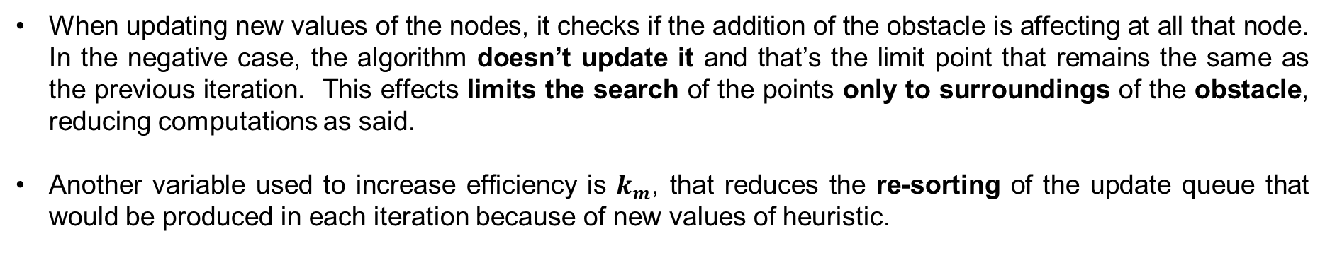
2.1 D* method for path planning Behavior
Allocation
D* lite utilizes two new metrics for each cell, where g represents the cost from the previous search and rhs the current iteration one.
$rhs = g → Consistent → Save for next iteration$
$$rhs ≠ g → Inconsistent → Update queue$$
When updating new values of the nodes, it checks if the addition of the obstacle is affecting at all that node. In the negative case, the algorithm doesn’t update it and that’s the limit point that remains the same as the previous iteration. This effects limits the search of the points only to surroundings of the obstacle, reducing computations as said.
Another variable used to increase efficiency is $k_{m}$, that reduces the re-sorting of the update queue that would be produced in each iteration because of new values of heuristic.

Slide 10
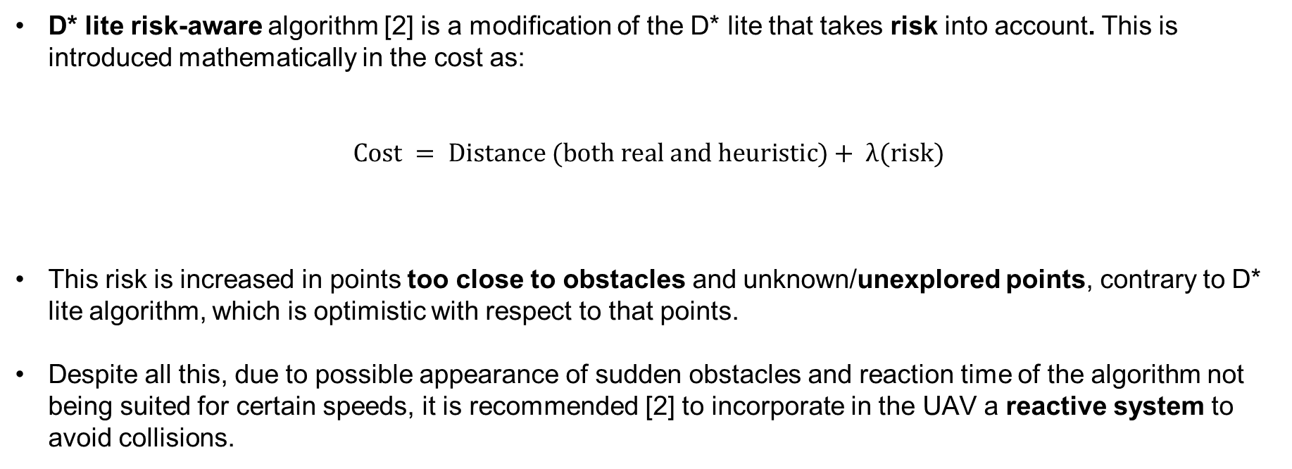
2.2 D* method for path planning D* lite risk-aware
D* lite risk-aware algorithm [2] is a modification of the D* lite that takes risk into account. This is introduced mathematically in the cost as:
$$Cost = Distance (both real and heuristic)+ λ(risk)$$
This risk is increased in points too close to obstacles and unknown/unexplored points, contrary to D* lite algorithm, which is optimistic with respect to that points.
Despite all this, due to possible appearance of sudden obstacles and reaction time of the algorithm not being suited for certain speeds, it is recommended [2] to incorporate in the UAV a reactive system to avoid collisions.
Allocation

Slide 11
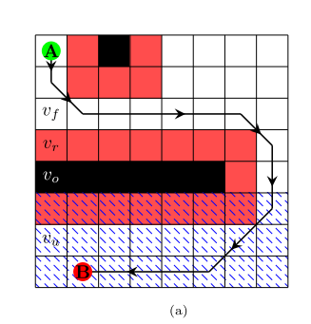
2.2 D* method for path planning D* lite risk-aware
Position Controller
Allocation

Slide 12
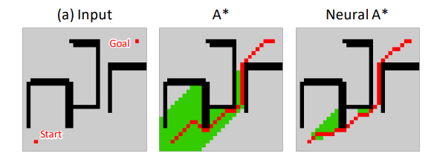
2.3 D* method for path planning D* lite with neural heuristic
This D* lite modification changes the traditional heuristic of Euclidean distance from that node to the goal/UAV with Guidance Map generated by a Convolutional Neural Network (CNN).
Drastically reduces node exploration (up to 90%), allowing the UAV to find optimal paths with significantly less CPU power [3].
Allocation

Slide 13
3. Conclusions

Slide 14
3.1. Conclusions
Computational Efficiency via Incremental Planning: D* Lite remains the industry standard for dynamic environments because it only updates the "inconsistent" nodes affected by new obstacles, avoiding recalculating the entire map.
Safety Through Risk-Awareness (D+*): Modern field-resilient navigation requires more than just avoiding obstacles; by treating unknown spaces and proximity to walls as "Risk Costs," we can ensure UAVs maintain a safety buffer and avoid the "optimistic" shortcuts that lead to dead ends.
Neural Guidance as the Future of Search: The integration of Deep Learning (Neural A*/D*) allows search-based algorithms to include visual "intuition." This drastically reduces node exploration—often by over 80%—while guaranteeing optimality and success that are missing from pure AI models.
Position Controller
Allocation

Slide 15
Sources
Position Controller
Allocation
[1] S. Koenig and M. Likhachev, "D* lite," in Proceedings of the Eighteenth National Conference on Artificial Intelligence (AAAI), 2002, pp. 476-483.
[2] S. Karlsson, A. Koval, C. Kanellakis, and G. Nikolakopoulos, "D+*: A risk aware platform agnostic heterogeneous path planner," Expert Systems with Applications, vol. 215, p. 119408, 2023.
[3] R. Yonetani, T. Taniai, M. Barekatain, M. Nishimura, and A. Kanezaki, "Path planning using Neural A* search," arXiv preprint arXiv:2009.07476v3, Jul. 2021.

Slide 16
Thanks for your attention

